Slide 1
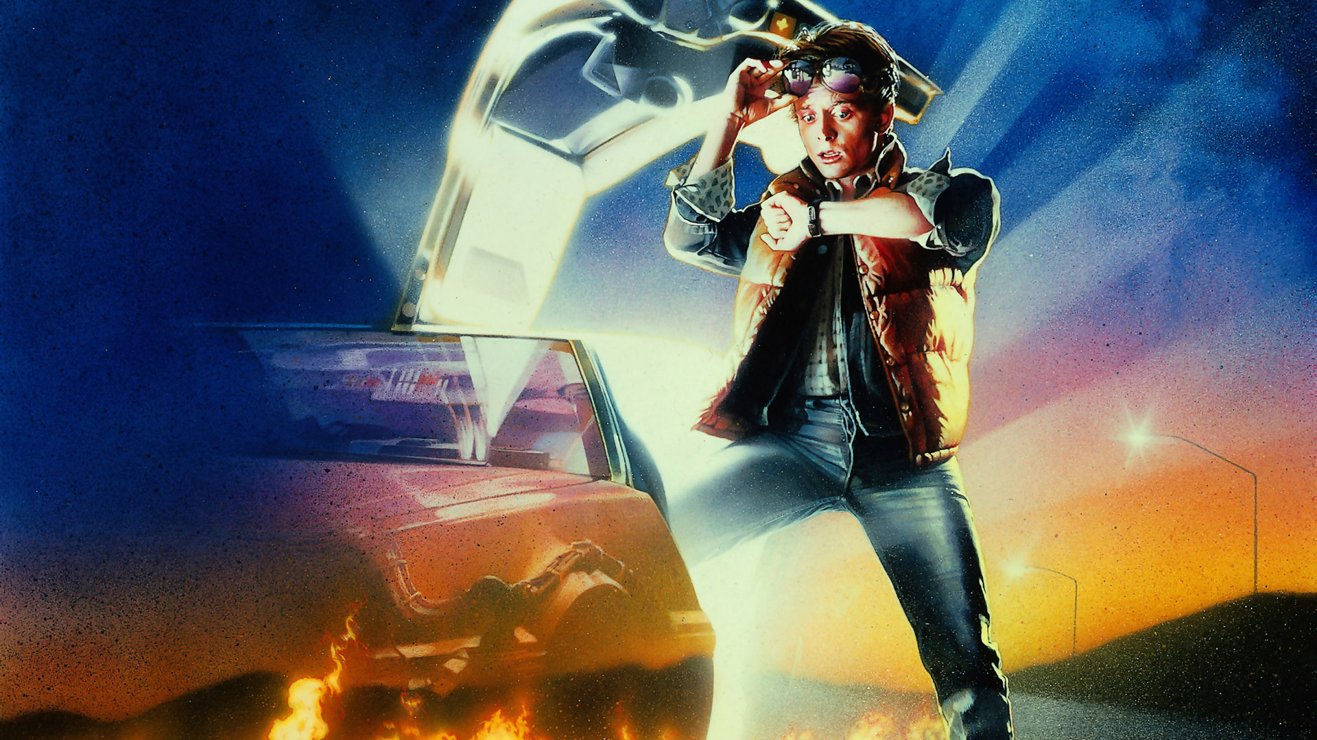
Watch Design
by Paul Teogalbo
EVC Engineering 18
Professor Entekhabi
Fall 2015

Slide 2
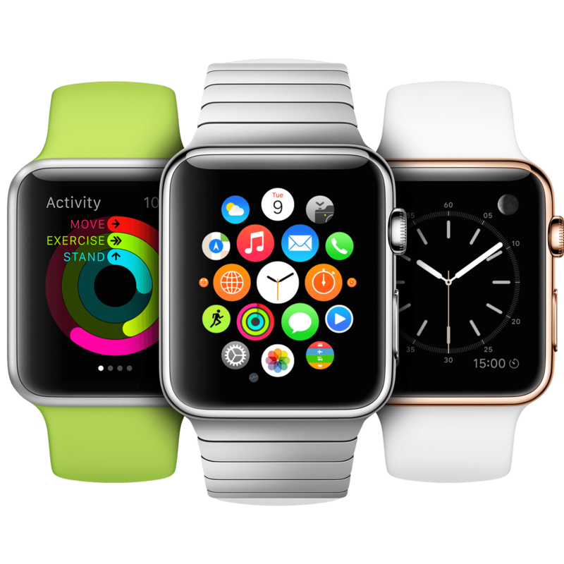
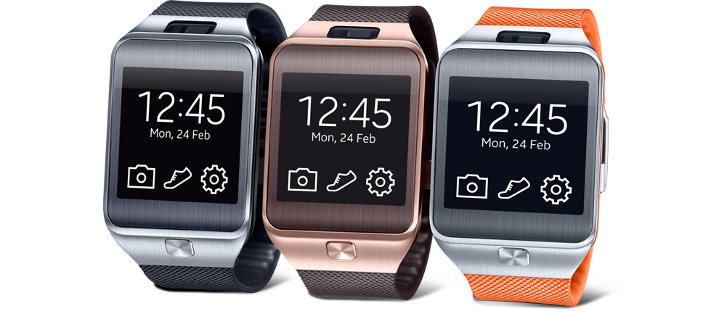
Modern Watches Today
Apple Watch
Samsung Gear

Slide 3
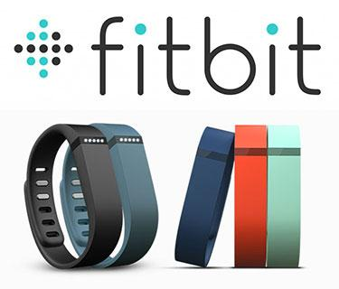
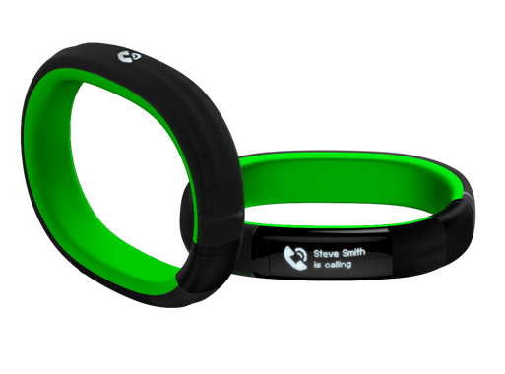
Modern Watches Today
Razer Nabu Smartband

Slide 4
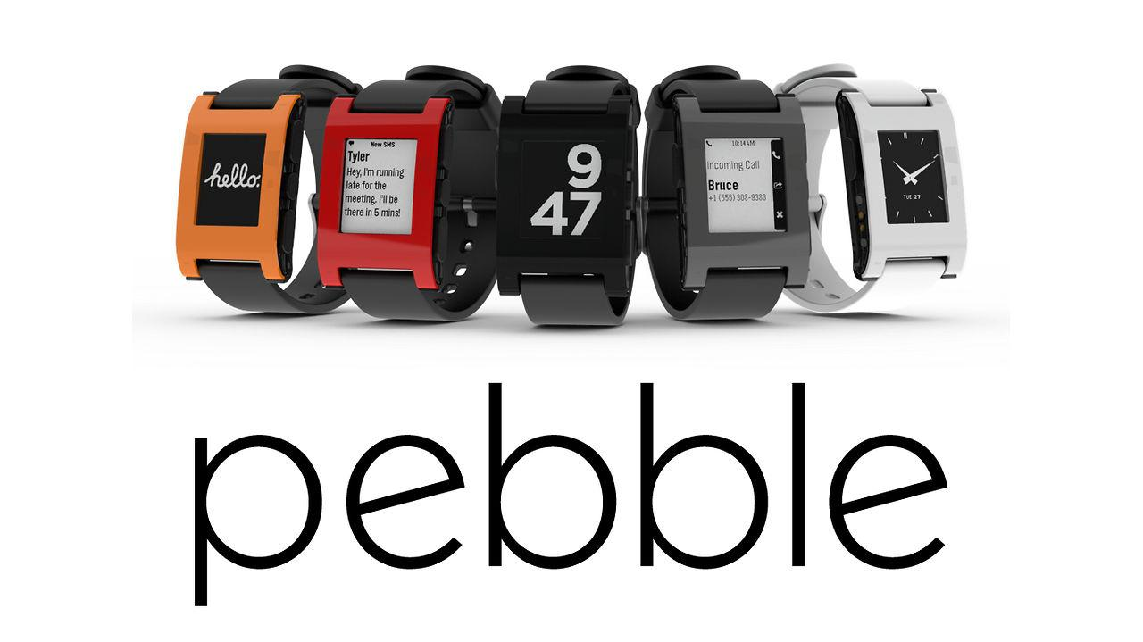
Notable Watches

Slide 5
Common Problems with “Smart” Watches
Short Battery Life:
-Apple Watch ~18hrs depending on use.
-Samsung Gear ~25hrs depending on use.
Recharge Time: -Apple Watch ~Overnight Charge

Slide 6
Common Problems with “Smart” Watches
Cost & Price:
-Apple Watch: 349+ -Samsung Galaxy Gear: $150
Serviceability: being able to be repaired easily & replaceable components
Durability

Slide 7
Target Objectives: Watch Design
Simplicity in terms of Functionality
Flexible Design
Based on a Smaller Budget
Put the “smart” into the watch not make “smartwatch”
Extend Battery Life & Reduce Rechargeability
Reliability and Serviceability(Repairability, fewer components.)
Durability

Slide 8
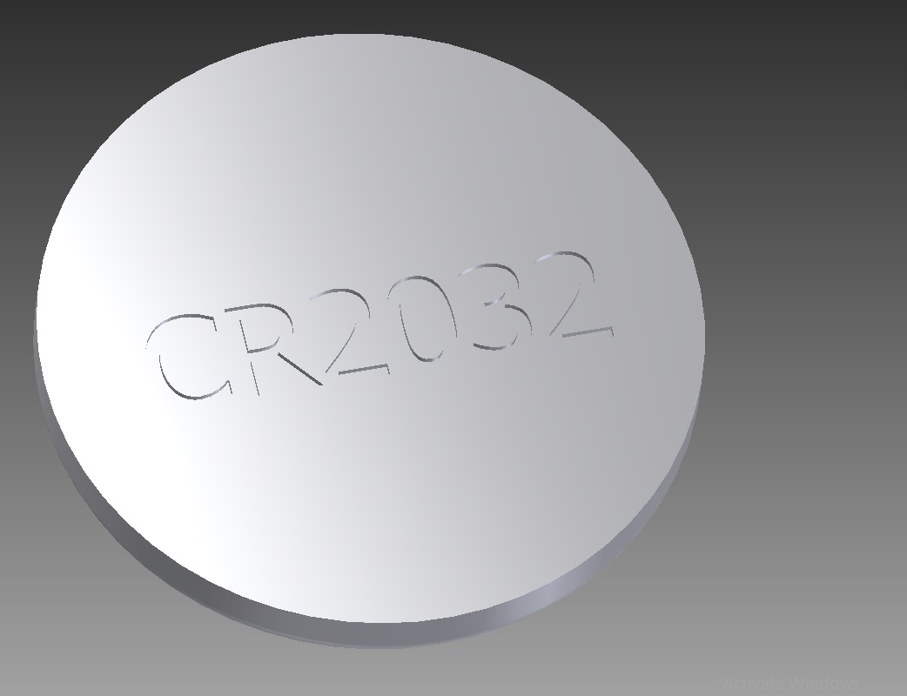
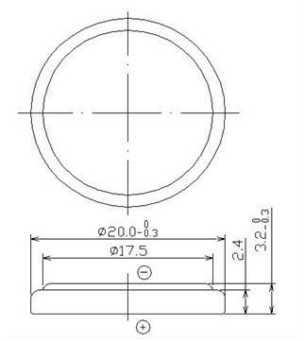
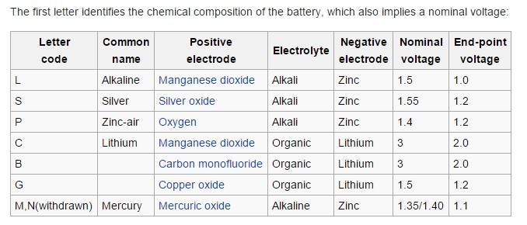
The “CR2032” Lithium Battery
Power Source:
Standard Watch battery @3.0V

Slide 9
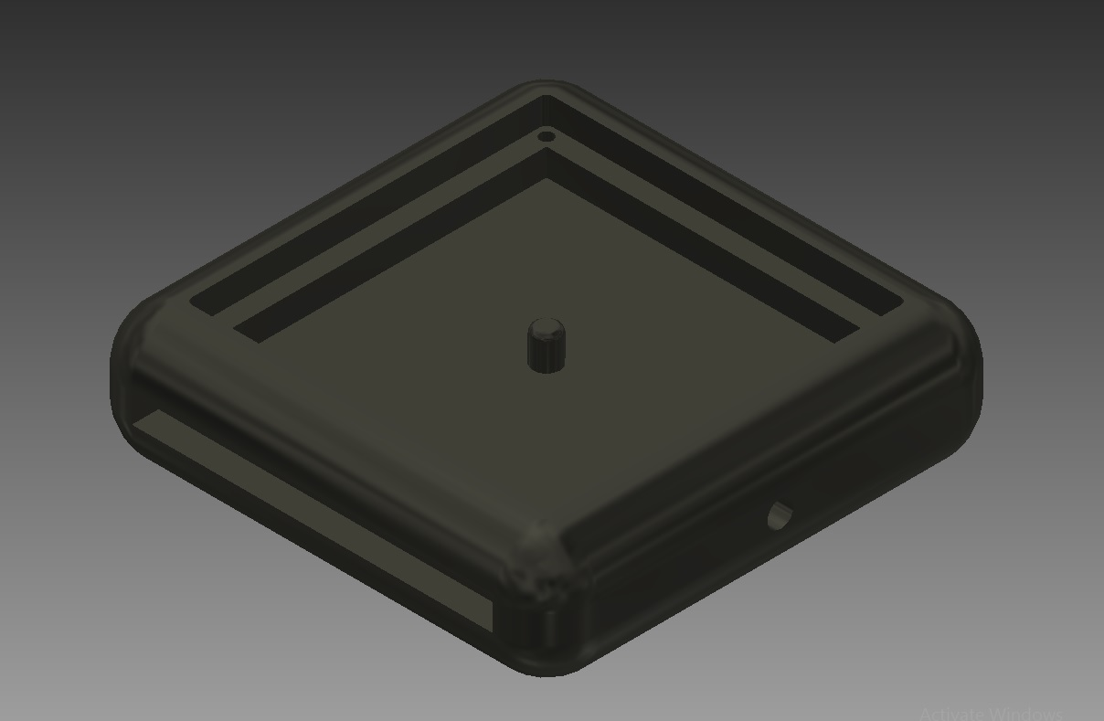
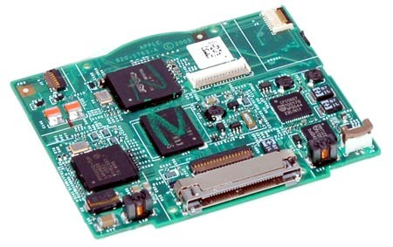
Design Choice: Polished Aluminum Chassis
Aluminum is:
-lightweight
-durable
-resistive to corrosion
-sealed, embedded logic board

Slide 10
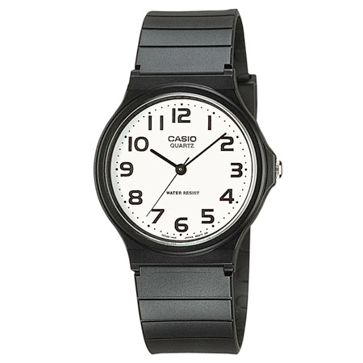
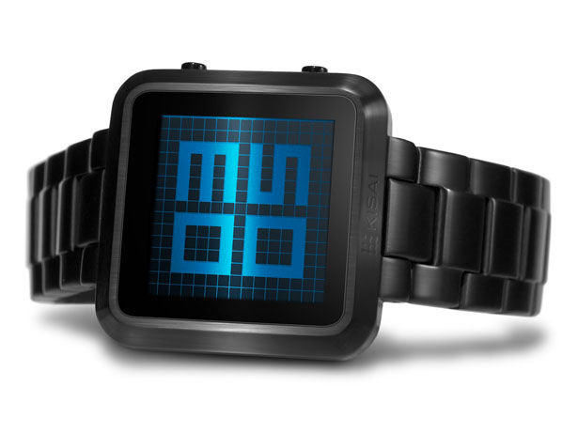
Design Choice: Analog vs. Digital
LCD-Liquid Crystal Display:
-vulnerable to being cracked
-can get dead spots
-expensive to repair
-toxic liquids

Slide 11
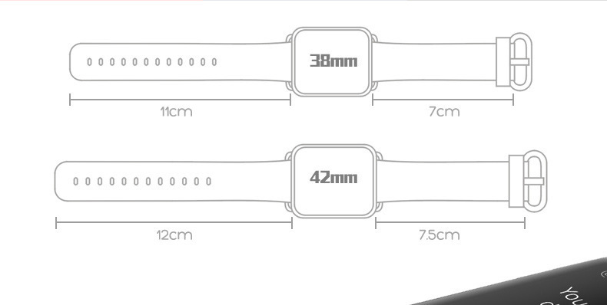
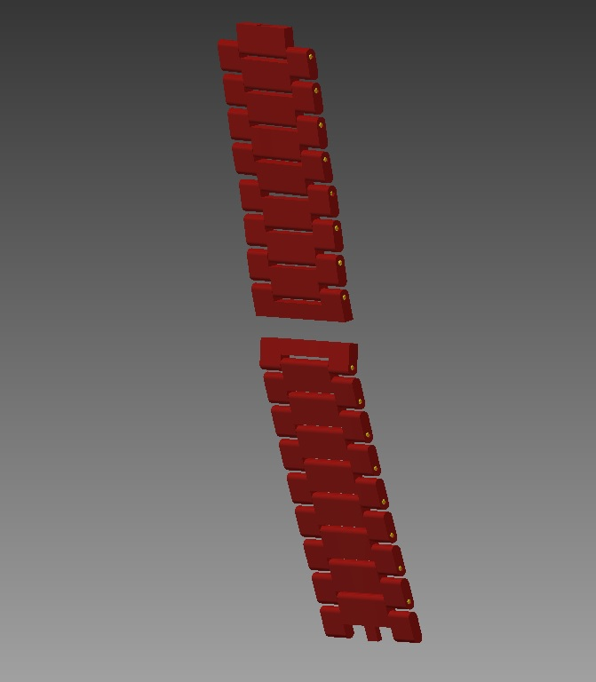
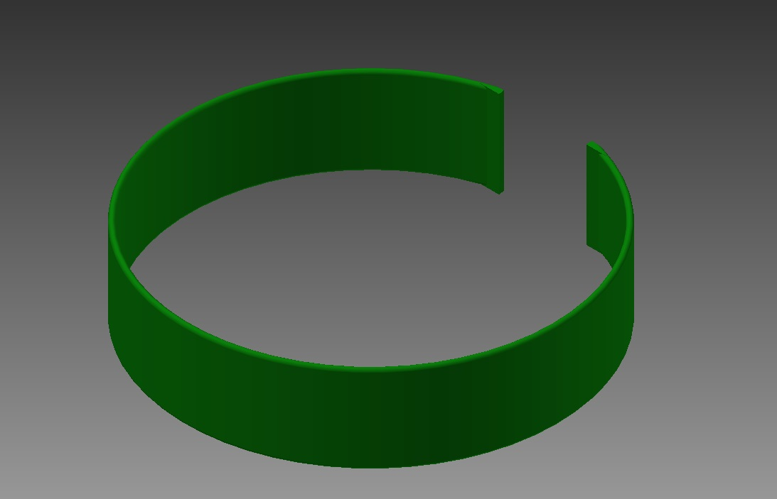
Design Choice: Wristband Strap Types
Silicone Rubber
Plastic TPU- Thermoplastic Urethane

Slide 12
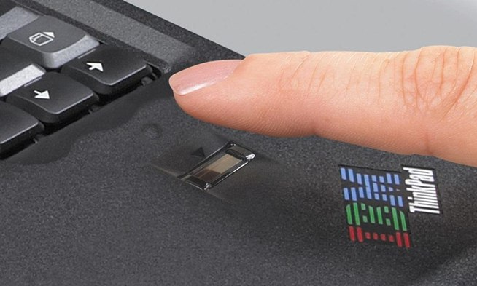
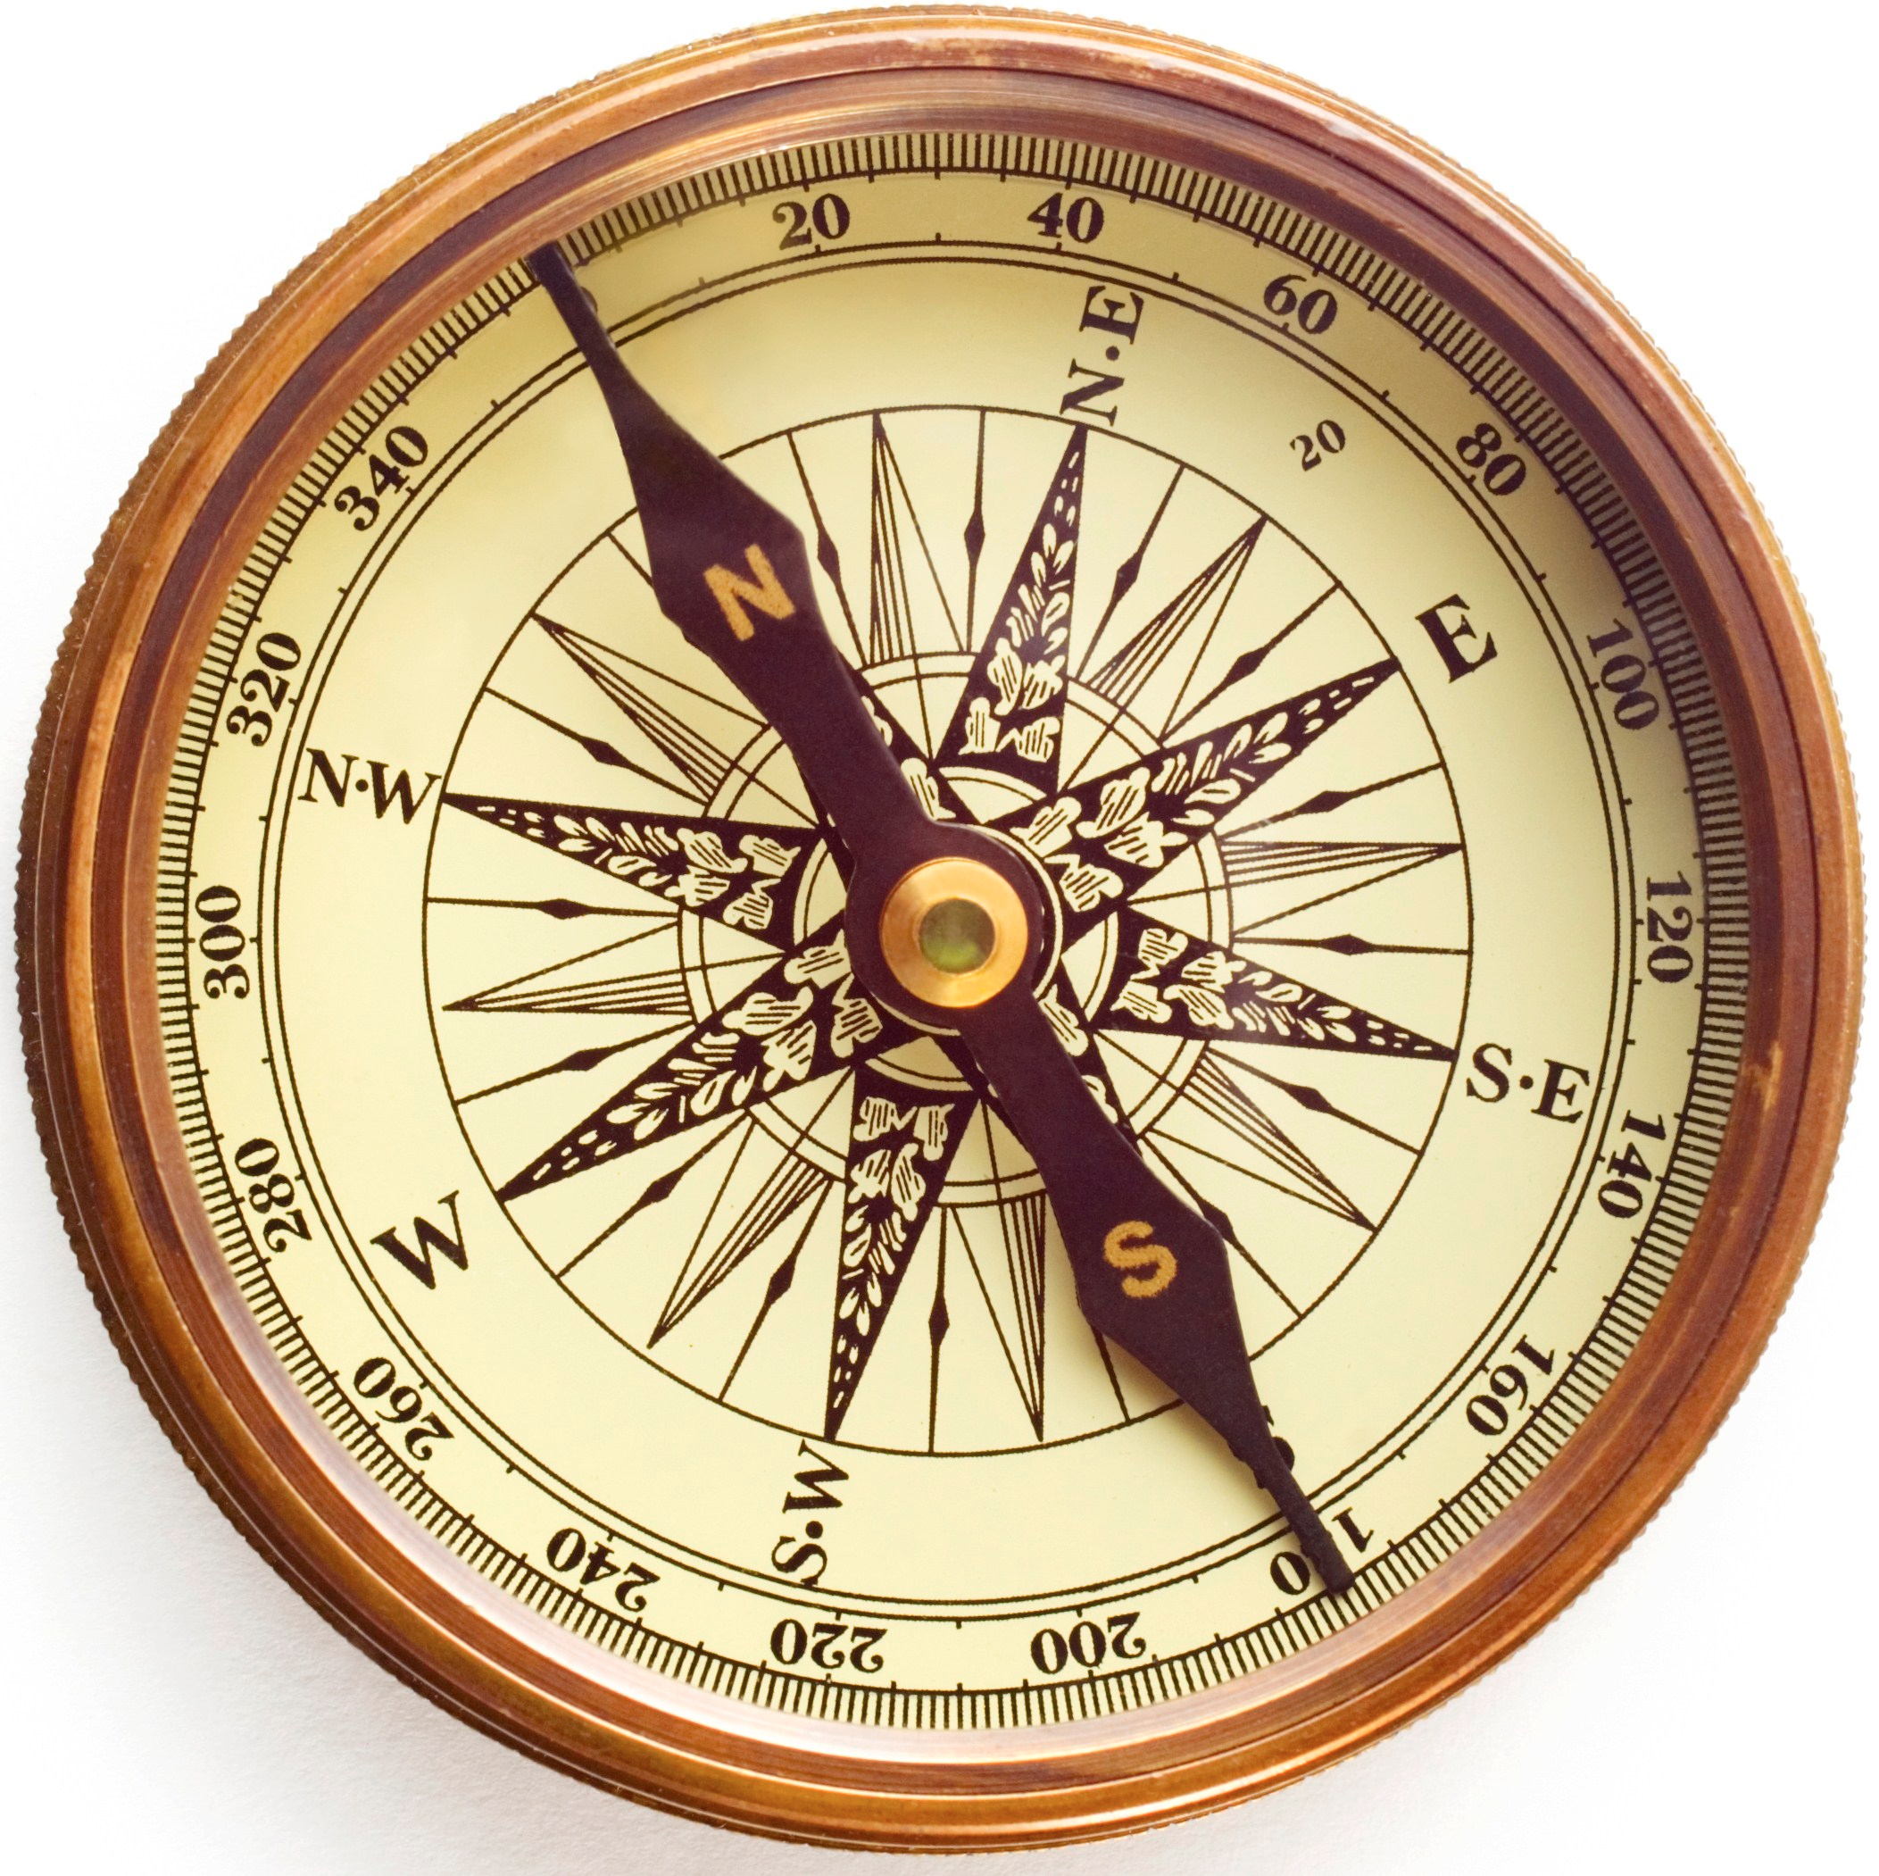
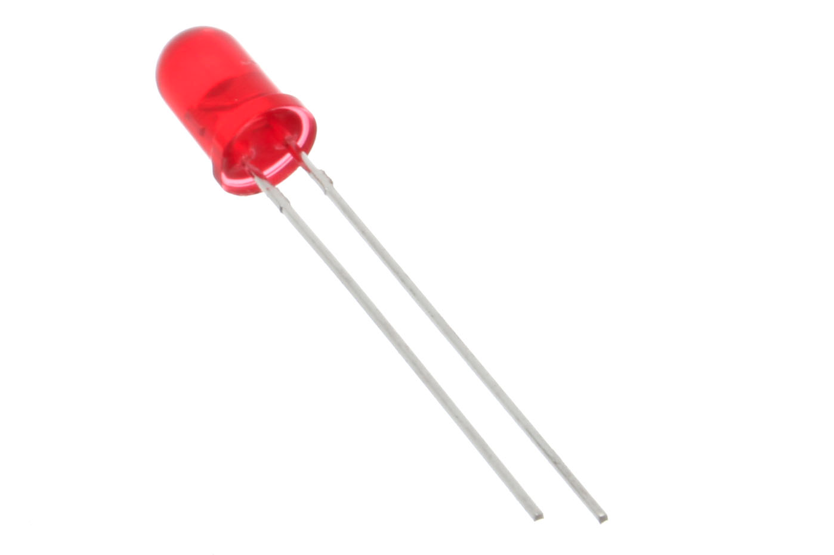
Design Choice: “Smart” watch
Biometrics Sensor
BPM Readings
Compass Function
LED? For flashlight? Light Emitting Diode

Slide 13
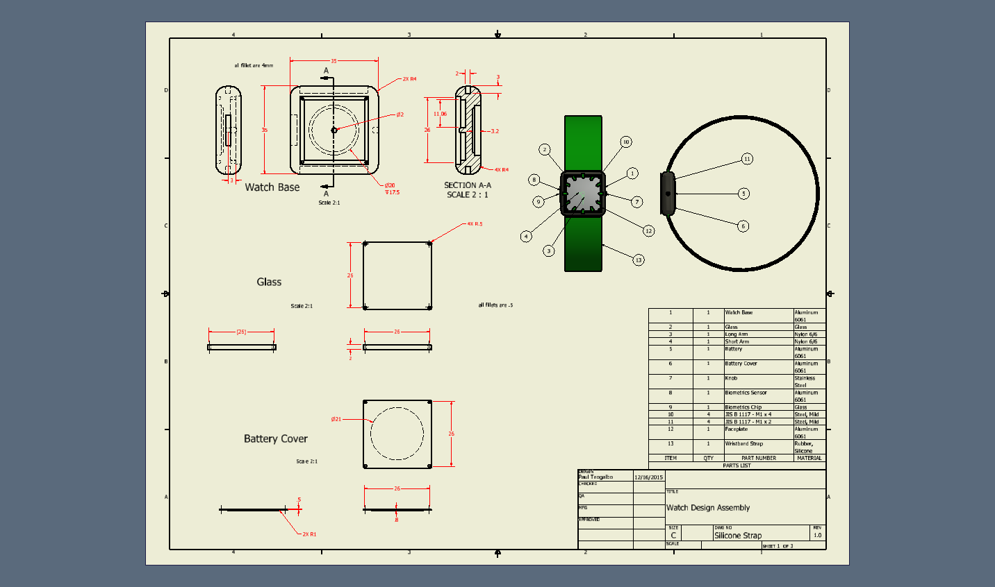
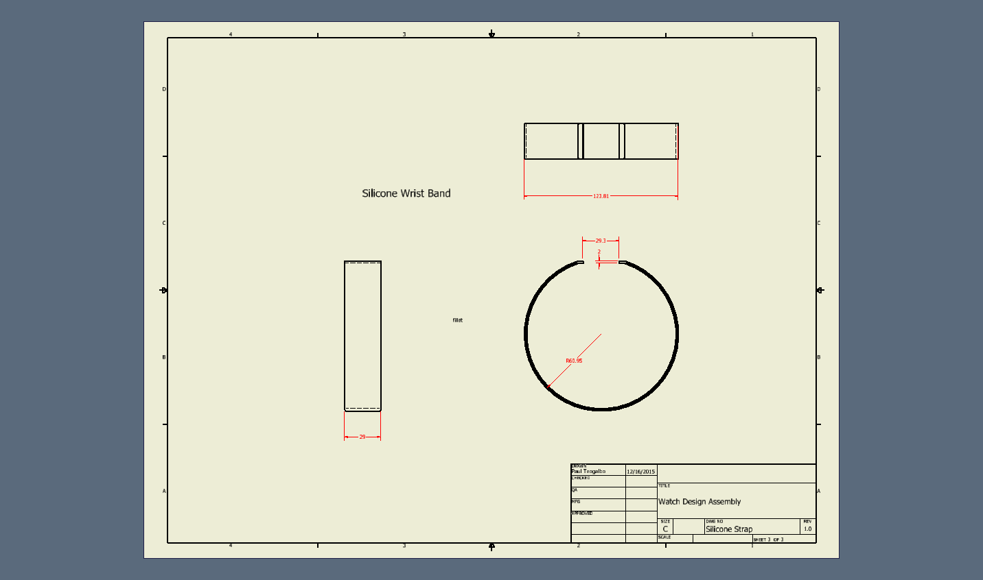

Slide 14
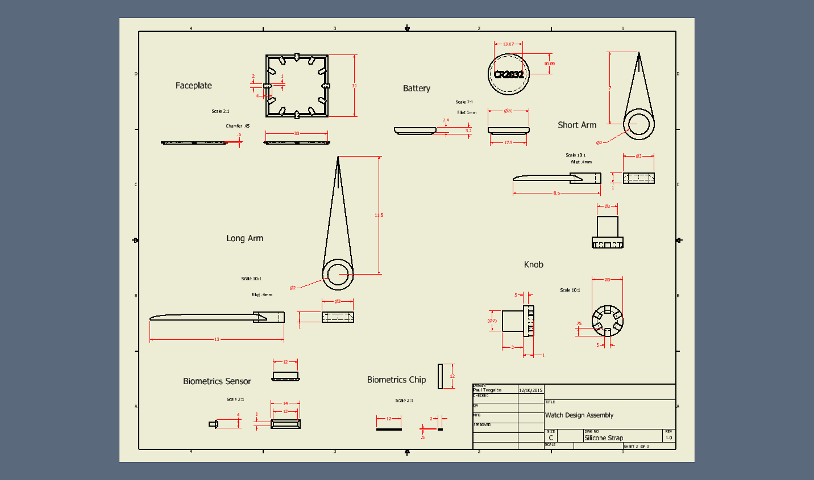

Slide 15
Watch Design: Assembly Animation
https://youtu.be/Ij4VuGYizu4

Slide 16
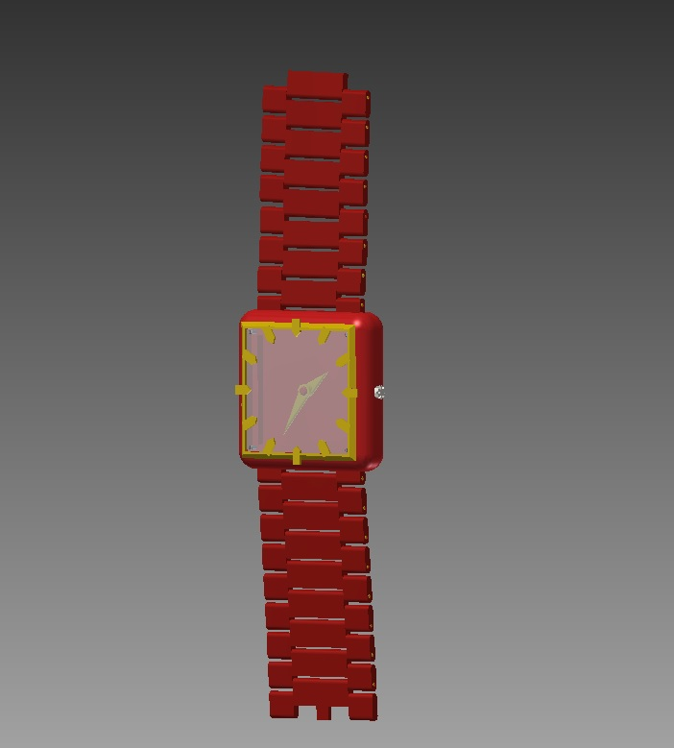
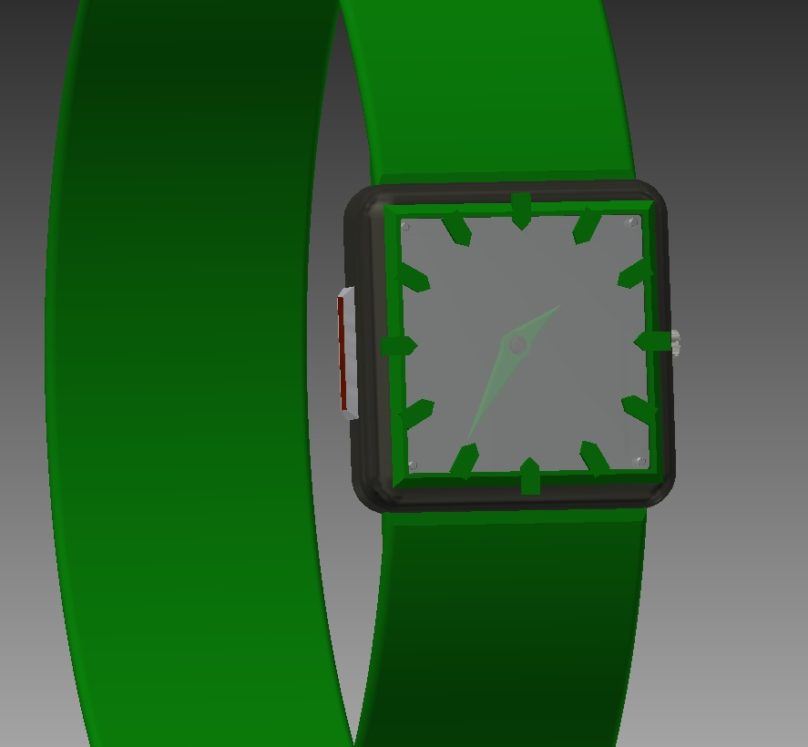
Final Product: Wrist Straps Design
Single Band Wrist Strap
TPU Connector Links Wrist Strap

Slide 17
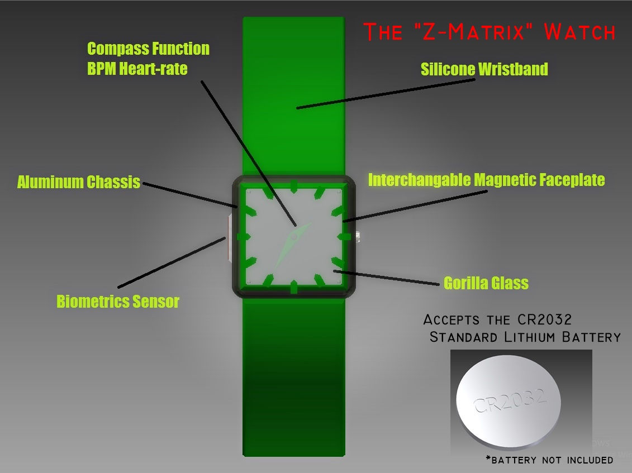
Final Product: Watch Design

Slide 18
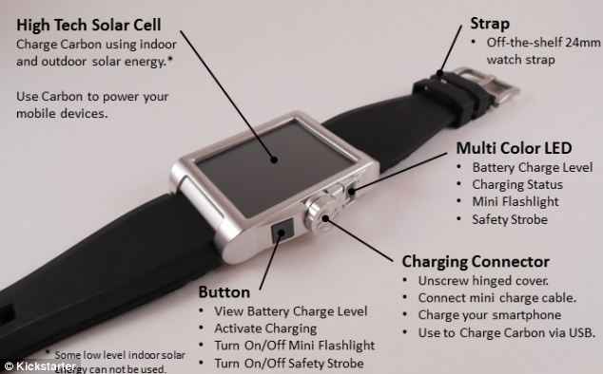

Suggestions for Future Designs:
Sustainable Green Design: -Solar Panels -Sustainable Materials: Biodegradable Plastics -“Battery-less”

